Slide 1
Found in Translation
Domain-Specific Languages for Simple, Composable Systems
Derrick W. Turk
terminus data science, LLC

Slide 2
A Recurring Problem
We have experts in some topic or “domain” whose jobs can be made easier with software
So we build the software
They love it!
And then: “well, in situation X, model A doesn’t really apply… unless condition Y”
“Can you add an option for that?”
So we do

Slide 3
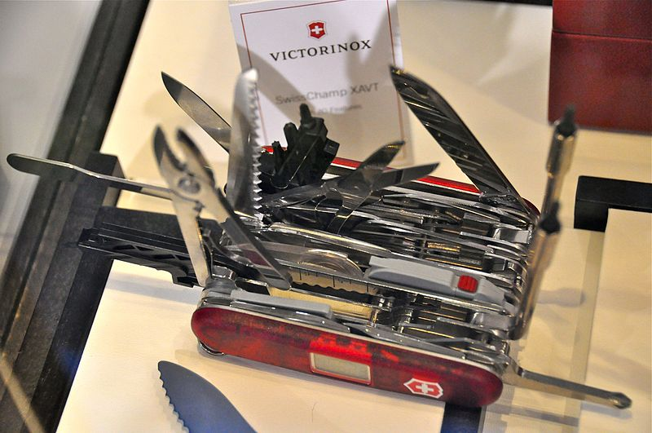

The Lifecycle of “Configurable” Systems
New, “elegant” system
“We don’t need all that cruft…”
Mature, “flexible” system
“Can you add an option for that?”

Slide 4


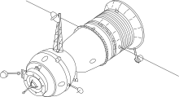
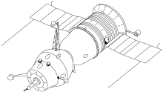
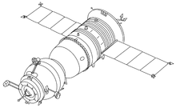
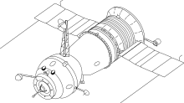
Simplicity = Longevity
Complex
Simple
“There are two ways of constructing a software design: One way is to make it so simple that there are obviously no deficiencies, and the other way is to make it so complicated that there are no obvious deficiencies. The first method is far more difficult.”
– C.A.R. Hoare

Slide 5
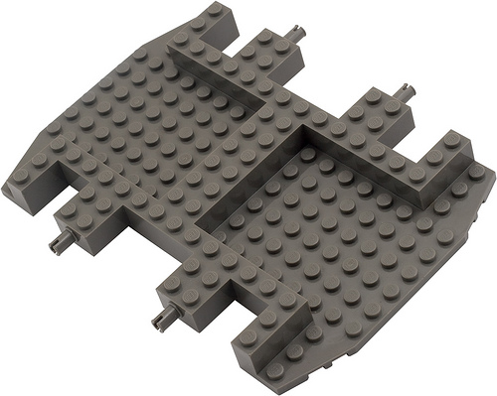
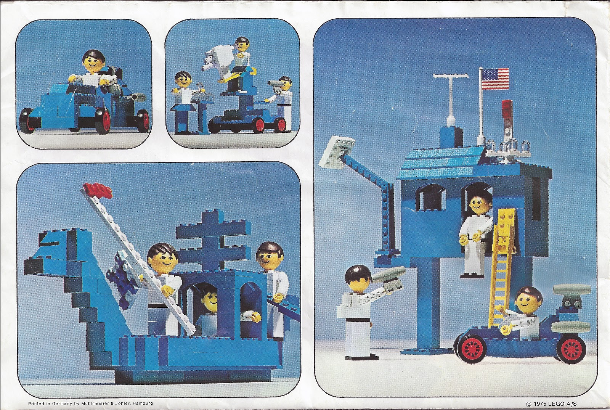
Composability = User Intuition + Creativity
Not Composable
Composable

Slide 6
Notation Is A Technology
MMXVII
MCMLXXXVIII
= ???
2017
1988
= ???

Slide 7
Notation Is A Technology
MMXVII
MCCCCCCCCCLXXXVIII
= ???
2017
1988
= ???

Slide 8
Notation Is A Technology
M
CCCCCCCCCLXXI
= ???
2017
1988
= ???

Slide 9
Notation Is A Technology
CCCCCCCCCLXXXXIIIIIIIIII
CCCCCCCCCLXXI
= ???
2017
1988
= ???

Slide 10
Notation Is A Technology
= XXIIIIIIIII
2017
1988
= ???

Slide 11
Notation Is A Technology
= XXIX
2017
1988
= ???

Slide 12
Notation Is A Technology
1
= XXIX
2007
1988
= 9

Slide 13
Notation Is A Technology
1
1
= XXIX
1007
1988
= 9

Slide 14
Notation Is A Technology
1
1
= XXIX
1907
1988
= 29

Slide 15
Notation Is A Technology
= XXIX
= 29

Slide 16
Domain-Specific Languages
Let users express their problems in their vocabulary
Give them simple, composable parts (“words”)
And let them build up larger systems “in their own words”
It’s on us to figure out how to turn these domain-specific programs into efficient “solutions”
That is: parsing, interpreting or compiling, executing

Slide 17
CSS (cascading style sheets) the domain: formatting web documents
body {
background: white;
color: black;
font-family: "Gill Sans", "Gill Sans MT", "Cabin", sans-serif;
}
.footer {
text-align: center;
clear: both;
font-family: "Jura", sans-serif;
padding-top: 50px;
}
.footer h6 {
font-size: medium;
}

Slide 18
INFORM 7 the domain: text adventure games
To destroy (item - a person):
if the item is the player:
say "That turns out to have been a humongous mistake.";
end the game in death;
clear connections to the item;
let context be the holder of the item;
move corpse to context;
obliterate the item.
To destroy (item - a thing):
clear connections to the item;
let context be the holder of the item;
if the item is visible and something underlies the item:
say "[line break]Left behind [is-are list of things which underlie the item].";
now every thing which underlies the item is in the context;
obliterate the item.
from Damnatio Memoriae by Emily Short

Slide 19
STAN modeling language domain: Bayesian inference by Hamiltonian Monte Carlo
data {
int<lower=0> J; // number of schools
real y[J]; // estimated treatment effects
real<lower=0> sigma[J]; // s.e.’s of effect estimates
}
parameters {
real mu; // population mean
real<lower=0> tau; // population sd
vector[J] eta; // school-level errors
}
transformed parameters {
vector[J] theta; // school effects
theta <- mu + tau*eta;
}
model {
eta ~ normal(0, 1);
y ~ normal(theta, sigma);
}
from Bayesian Data Analysis, by Gelman et al.

Slide 20
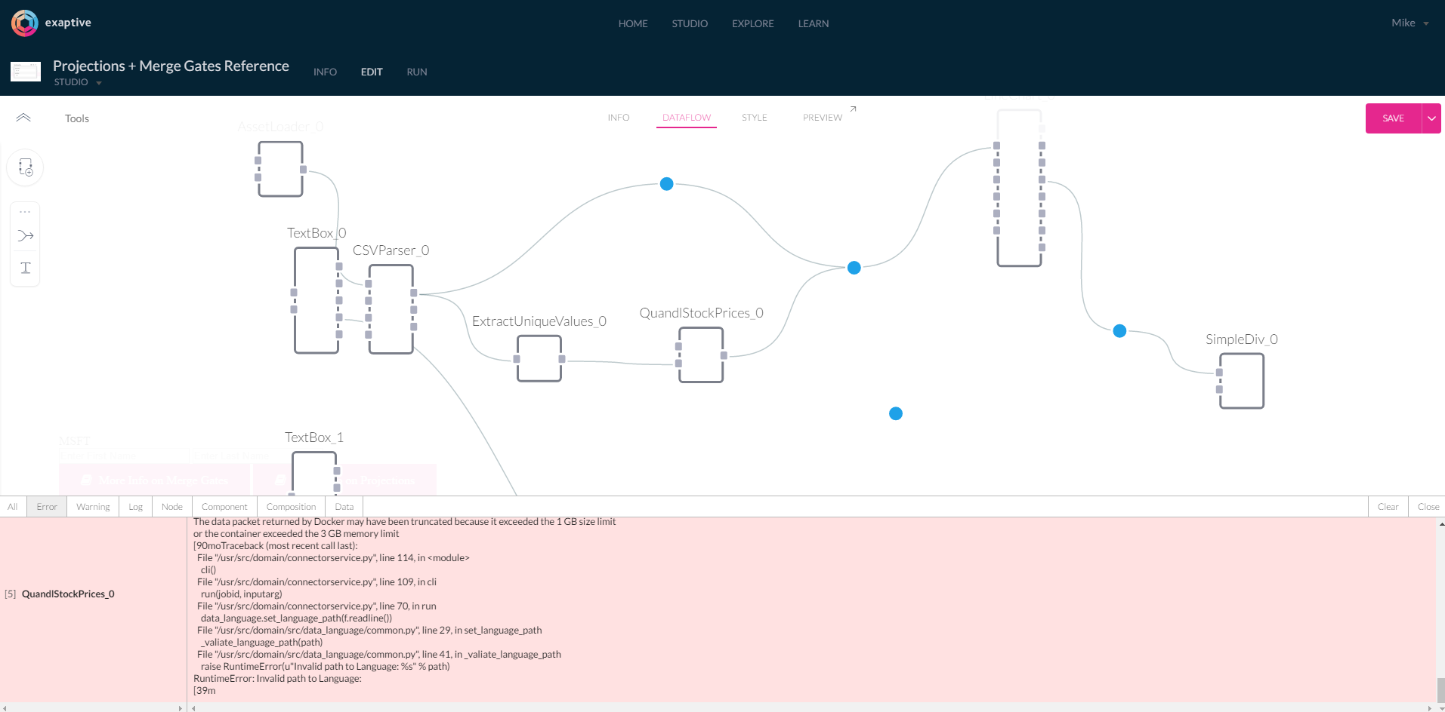
Exaptive visual dataflow language domain: dataflow design for interactive analytics applications

Slide 21
Case Study: APML Apache Portfolio Model Language
Apache has built a sophisticated set of teams, processes, and technology for modeling, managing, and optimizing the corporate portfolio
Fully probabilistic characterizations of available opportunities: timing, dependencies, cashflows
Optimized for expected NPV under constraint and environment “scenarios”
See SPE-187162-MS

Slide 22
Case Study: APML Apache Portfolio Model Language
We’ve also built a high-performance post-processor for Monte Carlo simulation
Run the “optimized” selections under many probabilistic realizations (based on modeled uncertainty)
Report mean, P90, P50, P10 for each cashflow item (e.g. total capital, gross oil…)

Slide 23
Case Study: APML Apache Portfolio Model Language
This worked well, but interesting questions look less like
“what’s the P90 total oil production in 2018 for the Permian?”
and more like
“what’s the probability of achieving our cashflow targets, while also staying within the desired capital budget?”
In fact, there are an infinite number of these interesting questions… and the programmer is the worst person of all to try to guess them up front.

Slide 24
Case Study: APML Apache Portfolio Model Language
My solution: a simple expression language for describing how to aggregate and summarize cashflows and collect statistics from them
It allows arithmetic operations, discounting and rate-of-return calculations, cumulation over time, and simple logical comparisons (e.g. “does this value exceed this threshold?”)
Minimalist syntax (s-expressions) based on Lisp
Composable: operators nest in the expected way (“cumulative of total of NPV of difference of …”)
Trivially type-safe: everything’s a number
Easy to parse: prefix notation and (lisp style forms) remove ambiguity from the grammar (no PEMDAS hacks)

Slide 25
Case Study: APML Apache Portfolio Model Language
(statistics
(summary (by-attribute [Region]) each-year
(total [Wells Per Year])
(total [Net BOE Volume Mboe])
(total [Net Lifting LOE M$])
(total (+ [Net Capital M$]
[Net ITS M$]
[Net Capitalized OH M$]
[Net Leasehold M$]
[Net Seismic M$]))
as [Net Total Capital M$]
(total [Net ATCF 0 M$])
(cumulative (total (discount 0.10 [Net ATCF 0 M$])))
as [Cumulative Net ATCF 10 M$]
)
mean
(percentile 90)
(percentile 50)
(percentile 10)
)
First, we replicated existing (static reports) functionality in APML…

Slide 26
Case Study: APML Apache Portfolio Model Language
(statistics
(summary all-groups all-times
(and
(>= (total [Net ATCF 0 M$])
(average (* { 5 7 9 10 15 7 5 } 1000000)))
(>= (total [Net Oil Volume Mbbls])
1000000))
)
mean
standard-deviation
(percentile 90)
(percentile 50)
(percentile 10)
)
… but then we started building tools for ad-hoc investigations and “probability of achievement” queries.

Slide 27
Case Study: APML Apache Portfolio Model Language
name ::= [string]
bin-op ::= - | / | < | <= | > | >=
var-op ::= + | * | and | or
time-metric ::= year | month | time
metric ::= number
| { number… }
| name
| time-metric
| (discount number metric)
| (bin-op metric metric)
| (var-op metric…)
| (in-year integer metric)
summary-fn ::= total | average | irr
summary-metric ::= number
| (summary-fn metric)
| (cumulative summary-metric)
| (bin-op summary-metric summary-metric)
| (var-op summary-metric…)
…
summary ::= (summary group-spec time-spec summary-metric…)
…
stats ::= (statistics summary stats-metric…)

Slide 28

Language Processing is Tree Manipulation
Concrete Syntax
Abstract Syntax Tree
(/
(discount 0.10
[Net ATCF])
[Gross Oil])

Slide 29
Functional(ish) Programming for Languages
We’re going to end up constructing recursive structures (ASTs) and manipulating/rewriting/folding/reducing them
This is a great place to apply some key ideas from functional programming (and specifically, from ML-inspired languages):
Static type checking with inference
Algebraic data types
Pattern matching
Higher-order functions
Immutability*

Slide 30
ADTs, Pattern Matching, and Recursion
Expression AST and Evaluator
Haskell
Expression AST and Evaluator
C#
data Expr = Const Int
| Plus Expr Expr
| Sub Expr Expr
| Mul Expr Expr
| Div Expr Expr
eval :: Expr -> Int
eval (Const n) = n
eval (Plus e1 e2) = (eval e1) + (eval e2)
eval (Sub e1 e2) = (eval e1) - (eval e2)
eval (Mul e1 e2) = (eval e1) * (eval e2)
eval (Div e1 e2) = (eval e1) `div` (eval e2)
main :: IO ()
main = let e = Mul (Const 3) (Plus (Const 5) (Const 2)) in
putStrLn $ show $ eval e
abstract class Expr {
public abstract int Eval();
public class Const : Expr {
public int Val;
public override int Eval() => Val;
}
public class Plus : Expr {
public Expr Lhs;
public Expr Rhs;
public override int Eval() => Lhs.Eval() + Rhs.Eval();
}
public class Sub : Expr {
public Expr Lhs;
public Expr Rhs;
public override int Eval() => Lhs.Eval() - Rhs.Eval();
}
public class Mul : Expr {
public Expr Lhs;
public Expr Rhs;
public override int Eval() => Lhs.Eval() * Rhs.Eval();
}
public class Div : Expr {
public Expr Lhs;
public Expr Rhs;
public override int Eval() => Lhs.Eval() / Rhs.Eval();
}
}
class ExprEvaluator {
public static void Main()
{
var expr = new Expr.Mul {
Lhs = new Expr.Const { Val = 3 },
Rhs = new Expr.Plus {
Lhs = new Expr.Const { Val = 5 },
Rhs = new Expr.Const { Val = 2 },
},
};
System.Console.WriteLine(expr.Eval());
}
}

Slide 31

Obligatory Rust Pitch
pub enum Expr {
Const(i32),
Plus(Box<Expr>, Box<Expr>),
Sub(Box<Expr>, Box<Expr>),
Mul(Box<Expr>, Box<Expr>),
Div(Box<Expr>, Box<Expr>),
}
impl Expr {
pub fn eval(&self) -> i32 {
match *self {
Expr::Const(n) => n,
Expr::Plus(ref e1, ref e2) => e1.eval() + e2.eval(),
Expr::Sub(ref e1, ref e2) => e1.eval() + e2.eval(),
Expr::Mul(ref e1, ref e2) => e1.eval() * e2.eval(),
Expr::Div(ref e1, ref e2) => e1.eval() / e2.eval(),
}
}
}

Slide 32
Parsing: Growing Trees from Text
Parsing is “easy” (we stand on the shoulders of giants)…
…for correct programs
Providing good errors for incorrect programs is much harder
Parser combinators are great: build up parsers from atomic components
Look for parser combinator libraries that provide a “cut” operator… or build one yourself
constExpr = (Const . fromInteger) <$> integer
plusExpr = parens (do
lexeme $ char '+'
lhs <- lexeme expr
rhs <- lexeme expr
return (Plus lhs rhs))
…
expr = constExpr
<|> try plusExpr
<|> try subExpr
<|> try mulExpr
<|> try divExpr
parseExpr :: String -> Either ParseError Expr
parseExpr = parse expr ""
main :: IO ()
main = case parseExpr "(* 3 (+ 5 2))" of
Left err -> putStrLn $ show $ err
Right e -> putStrLn $ show $ eval e

Slide 33
Evaluation: Transform and Fold
We have a range of evaluation strategies, from “interpretation” to “compilation”
Interpretation = traverse/fold final AST to execute/evaluate final program; heavier runtime
Compilation = emit some executable structure/format from final AST; lighter runtime
50 shades of grey: bytecode interpreters, virtual machines, JIT compilers…
For APML, we fold the AST to evaluate expressions on each incoming data item (interpretation) with some initial setup

Slide 34
Object-oriented Language Survival Tips
The Visitor Pattern is your friend: decouple traversal logic from node-specific processing
Encode AST recursive types as abstract classes; leaf types as concrete classes
Don’t worry about “encapsulation” (properties/getters/setters etc.); AST types are generally immutable* “dumb data”

Slide 35
Dynamic Typing Survival Tips
As above, but…
☹
Lean heavily on metaprogramming and interactivity

Slide 36
Dynamic Typing Survival Tips
class Const:
def __init__(self, val):
self.val = val
def eval(self):
return self.val
def BinOp(fn):
class BinOpClass:
def __init__(self, lhs, rhs):
self.lhs = lhs
self.rhs = rhs
def eval(self):
return fn(self.lhs.eval(), self.rhs.eval())
return BinOpClass
Plus = BinOp(int.__add__)
Sub = BinOp(int.__sub__)
Mul = BinOp(int.__mul__)
Div = BinOp(int.__floordiv__)
…
# some assembly required
def expr(input):
return alt(
fmap(Const, token(integer)), # const, or
fmap(lambda xs: Plus(xs[1], xs[2]),
form(chain(token(char('+')), expr, expr))),
fmap(lambda xs: Sub(xs[1], xs[2]),
form(chain(token(char('-')), expr, expr))),
fmap(lambda xs: Mul(xs[1], xs[2]),
form(chain(token(char('*')), expr, expr))),
fmap(lambda xs: Div(xs[1], xs[2]),
form(chain(token(char('/')), expr, expr))),
)(input)
def main(argv):
source_expr = '(* 3 (+ 5 2))'
(_, e) = expr(source_expr)
if e is None:
print('Invalid expression.', file=sys.stderr)
return 0
print('{} = {}'.format(source_expr, e.eval()))

Slide 37
Parser Combinators
Parsec, for Haskell (https://hackage.haskell.org/package/parsec)
Sprache, for C# (https://github.com/sprache/Sprache)
nom, for Rust (https://github.com/Geal/nom)
“Monadic Parsing in Haskell” (http://eprints.nottingham.ac.uk/223/1/pearl.pdf)

Slide 38
Useful References
Crafting Interpreters (http://www.craftinginterpreters.com/)
Simplifying expression trees with the Visitor Pattern (https://stackoverflow.com/questions/43532261/clean-way-to-simplify-a-binary-expression-tree/43545950#43545950)
Pick your favorite PLs/compiler/parser textbook
Play around in various language paradigms / models of computation: DSLs may be imperative, declarative, typed, untyped… build a feel for the dimensions of the design space

Slide 39
Philosophical References
“Simple Made Easy” (https://www.infoq.com/presentations/Simple-Made-Easy)
Lambda the Ultimate [check out the Archives] (http://lambda-the-ultimate.org/)
Gallery of Programmer Interfaces (https://docs.google.com/presentation/d/1MD-CgzODFWzdpnYXr8bEgysfDmb8PDV6iCAjH5JIvaI/preview#slide=id.g1da0625f1b_0_56)
The Programming Language Checklist (http://colinm.org/language_checklist.html)

Slide 40


Special Thanks
David Fulford
Michael Berry
Ryan Hassen
Greg Starley
Luke Tucker
Leah Sullivan

